Slide 1
JWST Exposure Time Calculator
Colin Jacobs
JWST MASTER CLASS MELBOURNE 2022

Slide 2
The Basics
Find the official JWST Exposure Time Calculator (ETC) at: http://jwst.etc.stsci.edu From any browser.
To maintain a list of workbooks, log in with your MyST account
Sample workbooks and workbooks for the Example Science Programs in JDocs are available from the “Available Workbooks” page

Slide 3
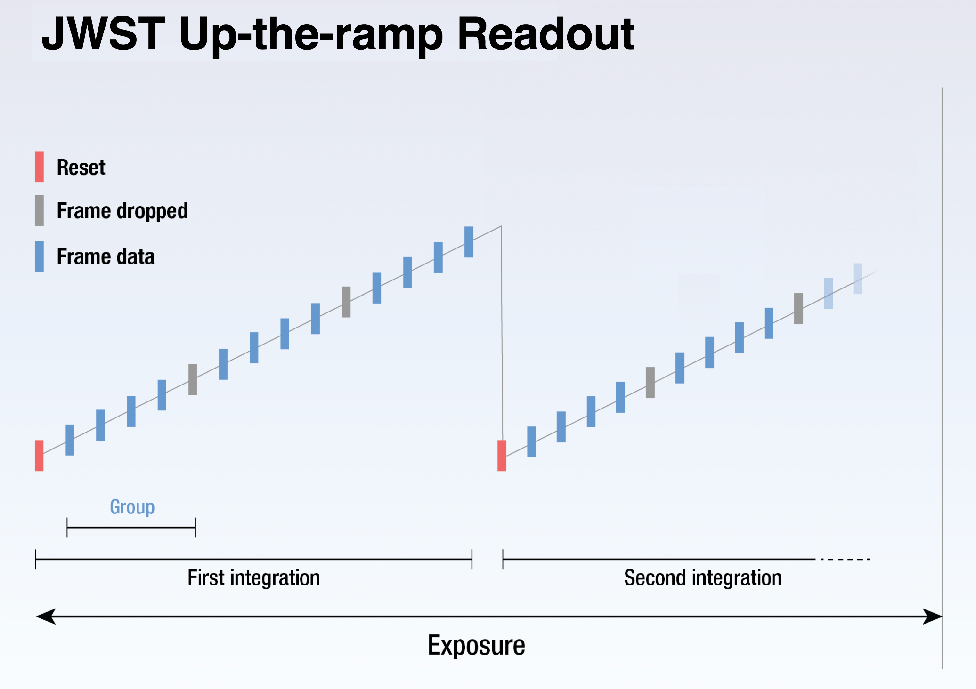
Reminder: MULTIACCUM readout scheme

Slide 4
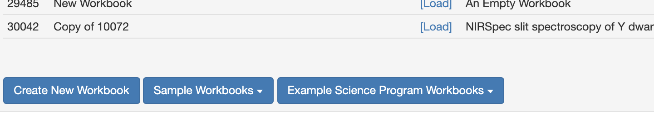
Finding Help
JWST Documentation (JDocs)
Example Science Programs & Sample Workbooks
Descriptions & guides available in JDocs (“Example Science Programs”)
Workbooks available from the ETC interface
YouTube tutorial videos
JWST Helpdesk

Slide 5
Algorithm and Architecture

Slide 6
ETC Architecture
ETC
3D ETC calculation engine (“Pandeia”)
Reference Database
Throughputs
Detector noise
PSFs
etc
Web Application
jwst.etc.stsci.edu
User interface
Collaborative functionality
JWST Background model
Also available via jwst_backgrounds

Slide 7
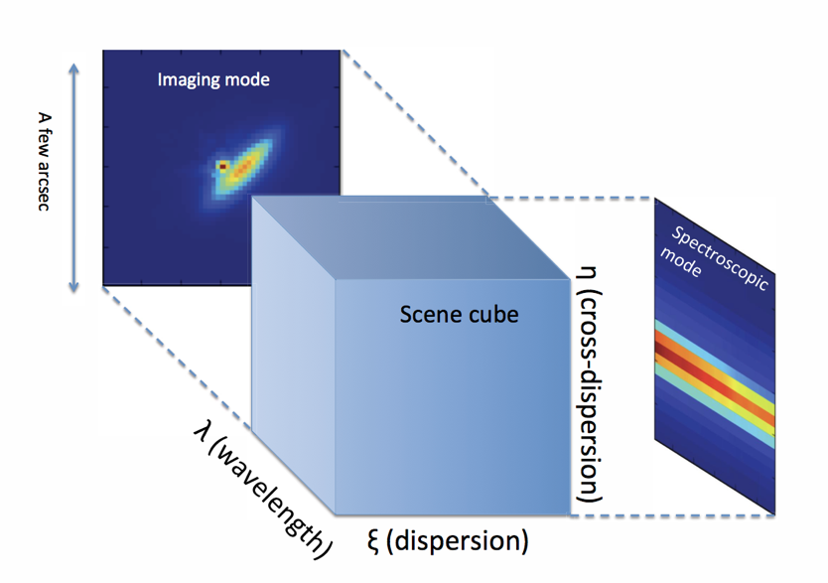
ETC Algorithm: Scene Cube
The scene contains the source(s) of interest for the science observation
Can be point-like or extended
Uploaded spectrum or from a range of SED options for lines and/or continuum:
Flat, power spectrum, blackbody continuum
Stellar model spectra
Galaxy template spectra
Added spectral lines (inc width, strength)

Slide 8
ETC Algorithm: Scene Cube
Create an abstract 3D representation of the scene from user input
Sample scene in spatial & spectral dimensions (conserving flux, resolving lines, ensuring resolution oversampled)
Convolve each wavelength plane with monochromatic PSF
Multiply by telescope throughput and convert to a photon rate
Multiply by instrument throughput and detector quantum efficiency (QE) – filter/disperser dependent
Project cube onto detector pixel array

Slide 9
ETC Algorithm: Detector Level
Apply appropriate detector noise to create the “noise image”
Extract photometry or 1D spectrum by applying linear noise propagation (the “strategy”)
Calculate signal to noise ratio

Slide 10
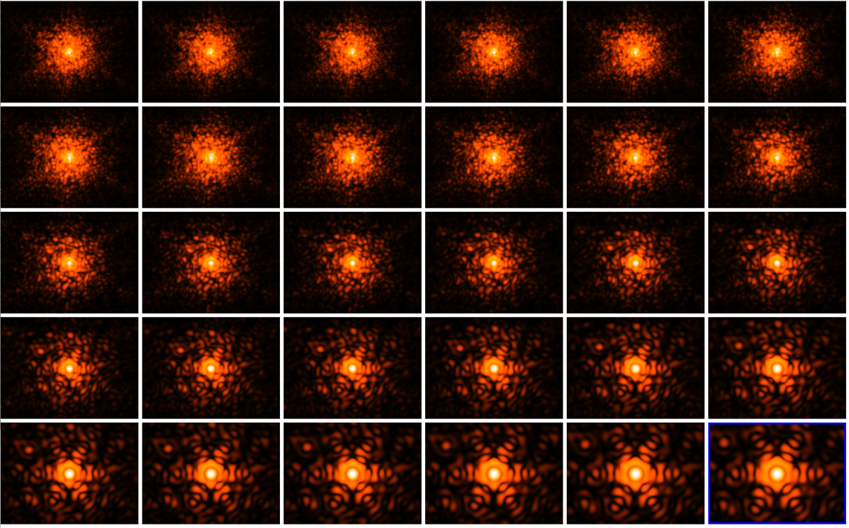
PSF Library
Convolution with PSF uses WebbPSF, which includes realistic wavefront errors
Library contains almost 5000 individual monochromatic PSFs
Oversampled by integer factor of pixel size (~3-4)
NIRCam SW PSFs (0.6-5.2 micron)

Slide 11
JWST Background
ETC calculation includes an estimation of background level
can be specified for a particular date & coordinates, OR coordinates + low/medium/high level (10th /50th /90th percentiles, resp)
can also be set to “none”
JWST uses a dynamical “background model generator” (BMG)
Components of the background are:
Galactic interstellar medium+stars
Zodiacal light (position+time dependent)
Out-of-field stray light (position+time dependent)
Telescope+spacecraft thermal emission

Slide 12
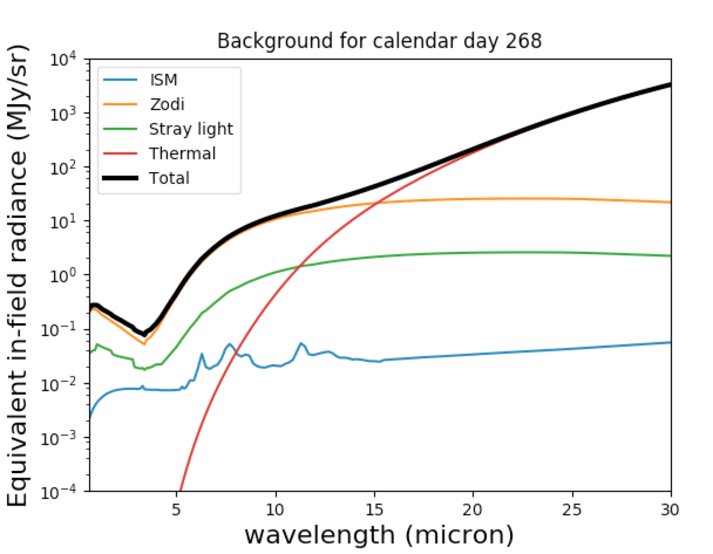
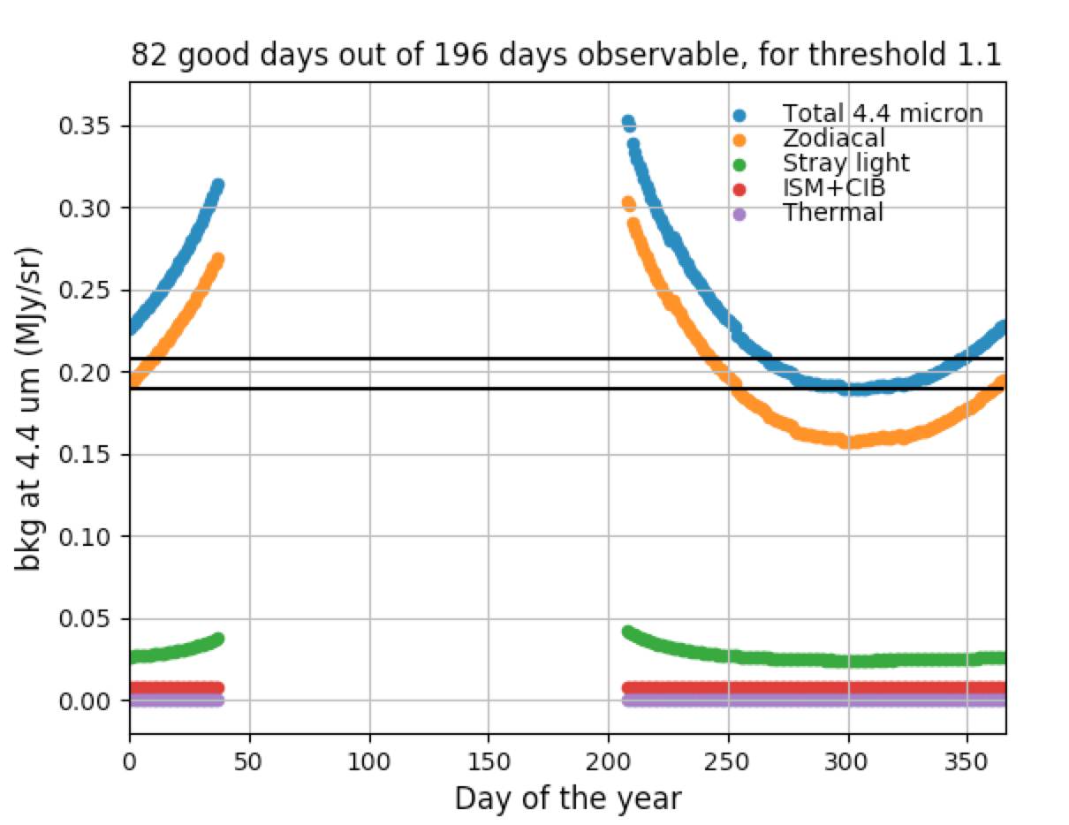
JWST Backgrounds Tool
Allows the user to compute the total background intensity and its components as a function of time, via a command line interface.
Installation instructions: https://jwst-docs.stsci.edu/jwst-other-tools/backgrounds-tool

Slide 13
ETC Strategies

Slide 14
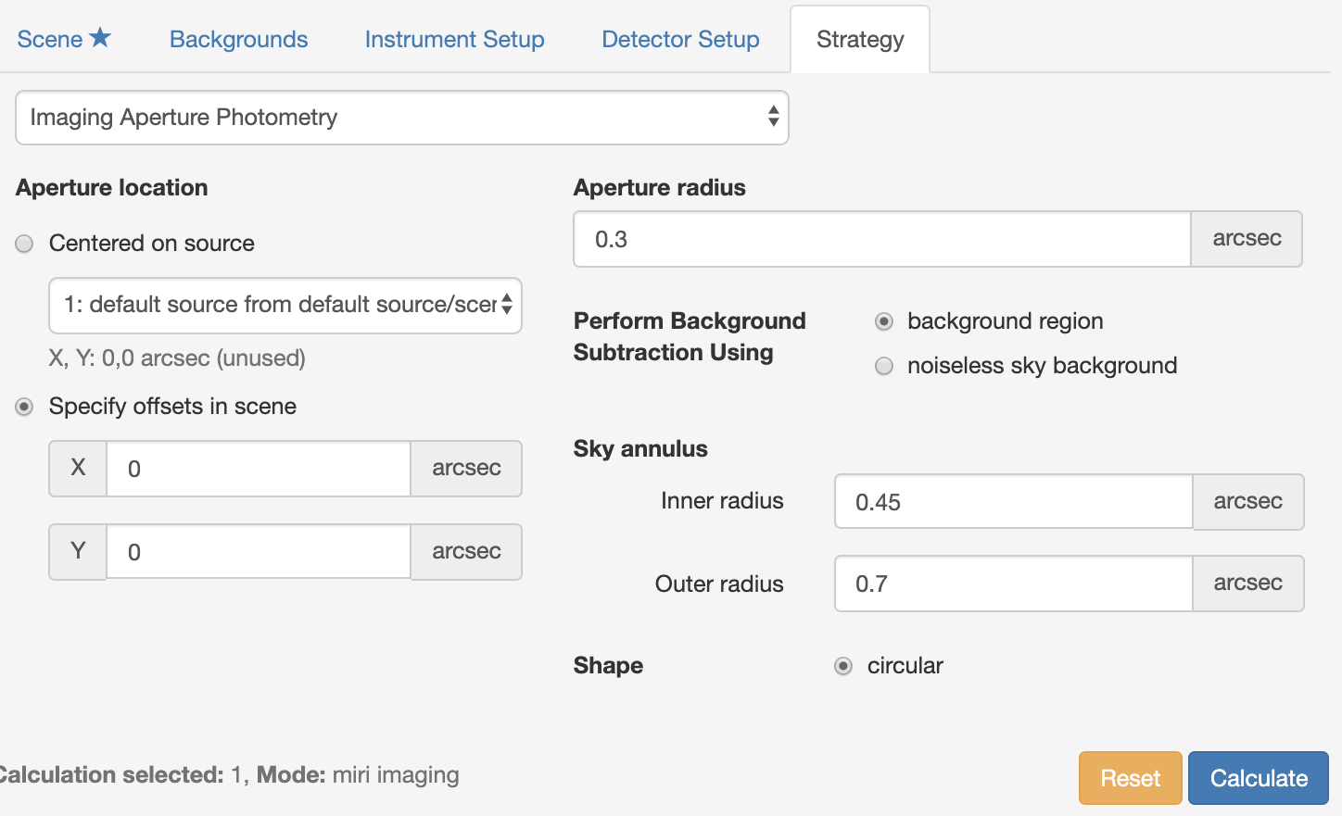
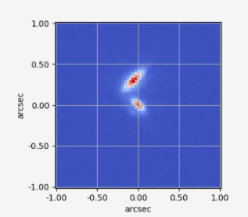
ETC Strategies
“Strategies” are prescriptions for how to go from a detector image to an extracted product
Examples of available strategies:
Imaging aperture photometry
Spectroscopic aperture extraction
IFU extraction with a background
Coronagraphic contrast
(Note: the extraction & background regions are shown here for illustration; they are not highlighted in this way in the ETC)

Slide 15
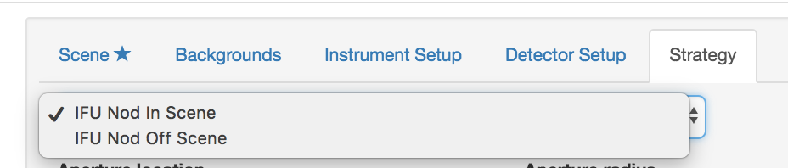
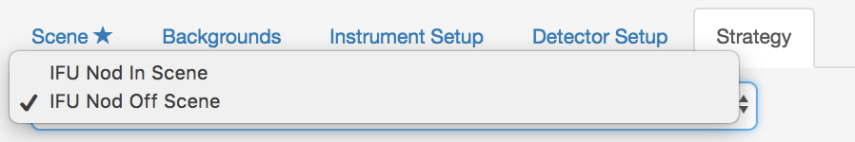
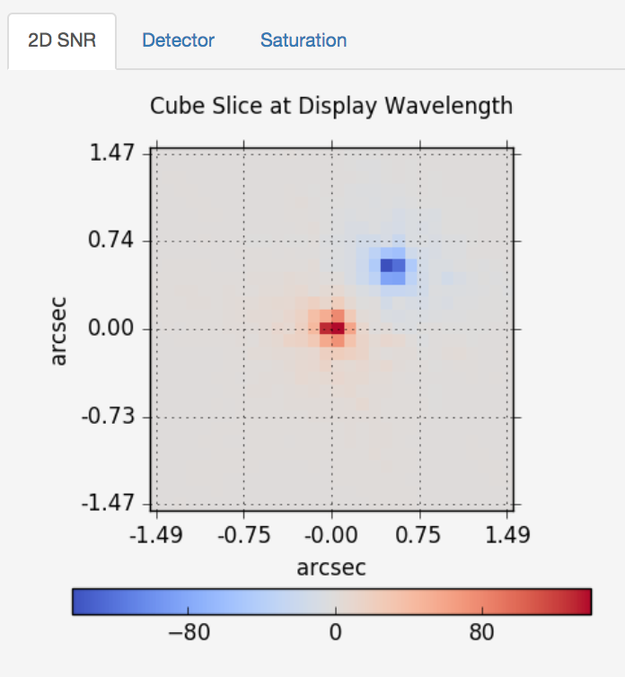
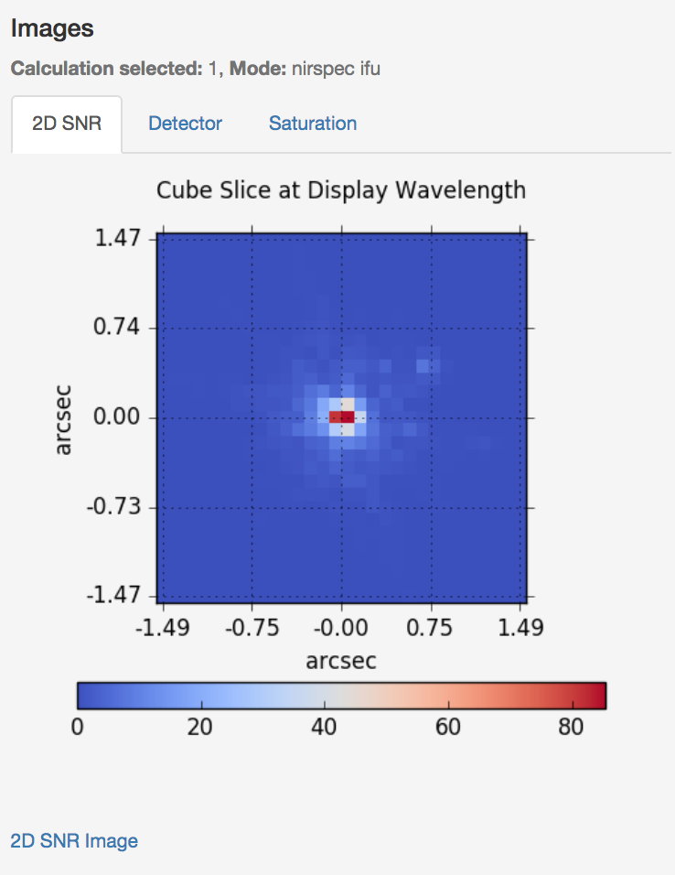
Spectroscopic Strategies
Aperture extraction / fixed slit
2 x half-height
Integral field spectroscopy

Slide 16
Target Acquisition calculations
The ETC has dedicated calculations to help plan Target Acquisition (TA) observations, which are recommended or required for many modes.
Models the GENTALOCATE algorithm that is executed on board
Uses the first – middle – last (or last-but-one) groups in an integration
Mitigates cosmic rays by taking minimum of two difference frames
Uses a fixed square aperture for centroiding (e.g. 3x3, 5x5 px)
Each instrument/mode has different range of options, settings & recommendatiojns for TA -> refer to mode-specific documentation to learn about the options.

Slide 17
Testing & Benchmarking the ETC
Benchmarked to sensitivity calculations provided by instrument teams.
Benchmark requirement: 10% in signal-to-noise ratio for 90% of calculations
In comparing a 3D to a 1D calculation, 10% is considered reasonable.
Compared calculated limiting sensitivities (10 sigma in 10,000 s) for all major instrument modes to independent calculations provided by the instrument teams.
Using the same reference data and parameter assumptions.
Since the benchmark, many parameters and some reference data have changed -> ETC is the best available estimate of JWST performance.

Slide 18
Ways to use the ETC

Slide 19
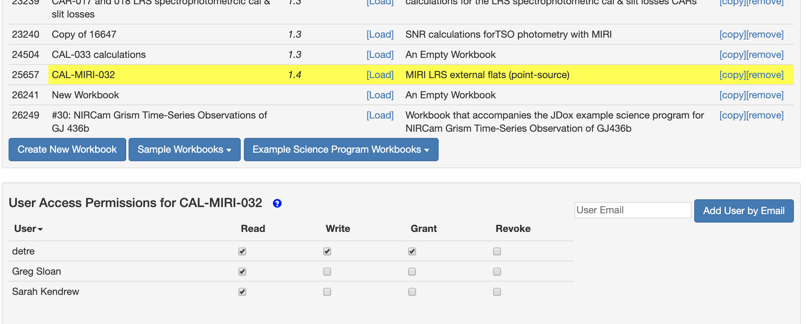
Web Application: A collaborative space
Workbooks can be shared with collaborators
Organise & maintain workbooks
Users can build a library of scenes & sources

Slide 20
Pandeia: a Python package
More functionality than available in the web application
Advanced scripting
Parameter space exploration
Complex scenes / many sources
Any JWST science mode accessible within one framework
https://pypi.org/project/pandeia.engine/
Installation & setup: https://jwst-docs.stsci.edu/jwst-exposure-time-calculator-overview/jwst-etc-pandeia-engine-tutorial/installing-pandeia
User guides: https://jwst-docs.stsci.edu/jwst-exposure-time-calculator-overview/jwst-etc-pandeia-engine-tutorial

Slide 21
Final checklist
There are many parameters affecting the predicted ETC sensitivities.
That’s the point of having a versatile tool, but comes with some responsibility.
Think about your background subtraction strategy.
Think about what extraction aperture is optimal (point or extended sources).
Is your background correct for your target – enter the actual RA, DEC. Investigate time dependency.
Check that your extraction aperture does not contain contaminating flux from other sources.
Is your selected readout pattern giving you the best SNR?

